Slide 1
Acids Base Reactions- I
Dr. Semanti Basu
Assistant Professor
Department of Chemistry
Bejoy Narayan Mahavidyalaya Itachuna, Hooghly, W.B., India

Slide 2
Definition of Acids & Bases
Different definitions and theories are involved to define a substance an acid or a base. Such different approaches are
1. Arrhenius theory of acids & bases proposed by Svante Arrhenius in 1883
2. Bronsted-dowry Theory proposed independently by J.N. Bronsted and J.M. Lowry in 1923,
3. Solvent system definition was introduced by Franklin in 1905 and was extended by Cady- Esley in 1928.
4. Lewis Theory, proposed by G.N. Lewis in 1930
5. Usanovich concept (1939)
6. Lux Flood concept, proposed by Lux in 1939 and extended by Flood in 1947.
All these theories don't mutually contradict, rather they get a common platform to stand. But they differ on the extent of generalization of the idea.

Slide 3
ARRHENIUS THEORY (1883)
Based on auto ionization process of H₂O (H₂O$⇌$H⁺ + OH⁻)
Acid: H containing compound gives H⁺ (proton) through ionisation in aqueous medium (HCl$⇌$H⁺ + Cl⁻)
Base: Oxygen and Hydrogen containing compound gives OH⁻ through ionisation in aqueous medium (NaOH $⇌$Na⁺ + OH⁻)
Neutralisation: H⁺ + OH⁻ $⇌$H₂O
HCl + NaOH $⇌$NaCl + H₂O
Thus it is expected that in any acid base neutralization, the heat of neutralisation for an equivalent amount of any acid base will be identical. For strong acid-base pair it true. But for weak acid base pair, some amount of heat energy is consumed to ionizing the weak acid and base.

Slide 4
ARRHENIUS THEORY (1883)
Limitations of the concept
1. The idea gets confined in aqueous media only but many acid-base reactions in nonaqueous media are well known.
2. Many compounds like SO₃, CO₂ etc. are not been considered as acid according to Arrhenius theory since they do not have any hydrogen, but can generate H⁺ in aqueous media. Similarly, many non-hydroxylic compounds like NH₃, Na₂CO₃ etc. also are not been considered as base according to Arrhenius theory since they are non-hydroxylic compound, but can generate OH⁻ in aqueous media

Slide 5
BRONSTED-LOWRY CONCEPT (1923)
It explains acid and base in terms of proton (H⁺) donation and acceptance. This theory is also called conjugate acid-base theory.
Acid: Proton donor (H⁺ donor, e.g. HCl)
Base: Proton acceptor (H⁺ acceptor, e.g. NH₃)
Acid₁ (A₁) + Base₂ (B₂)$⇌$ Base₁ (B₁) + Acid₂ (A₂)
B₁ is conjugate base of acid A₁
B₂ is conjugate base of acid A₂
H₂O is amphiprotic solvent, means H₂O can act as base towards strong acid & can act as acid towards strong base.
HCl (A₁) + H₂O (B₂) $⇌$Cl⁻ (B₁) + H₃O⁺ (A₂)
NH₃ (B₁) + H₂O (A₂) $⇌$NH₄⁺ (A₁) + OH⁻ (B₂)
Neutralisation reaction:
H₂O (A₁) + H₂O (B₂)$⇌$ H₃O⁺ (A₂) + OH⁻ (B₁)
NH₃ (A₁) + NH₃ (B₂)$⇌$ NH₄⁺ (A₂) + NH₂⁻ (B₁)
H₂SO₄ (A₁) + H₂SO₄ (B₂)$⇌$ H₃SO₄⁺ (A₂) + HSO₄⁻ (B₁)

Slide 6
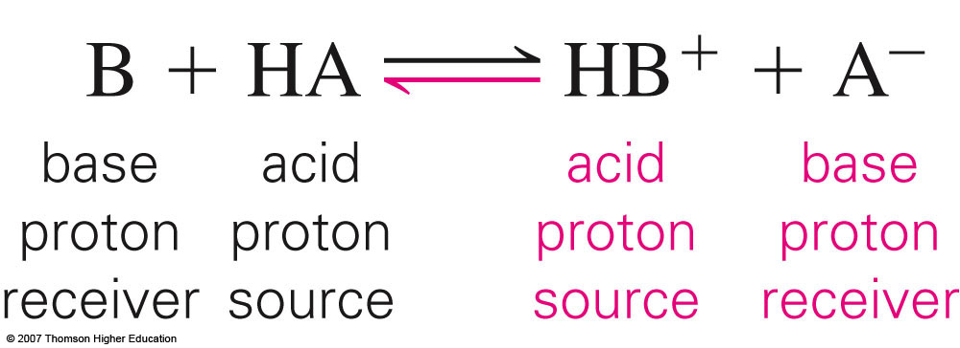
Brønsted-Lowry Theory of Acids & Bases
Conjugate Acid-Base Pairs
General Equation

Slide 7
Conjugate Acid-Base Pairs
Notice that water is both an acid & a base = amphoteric

Slide 8
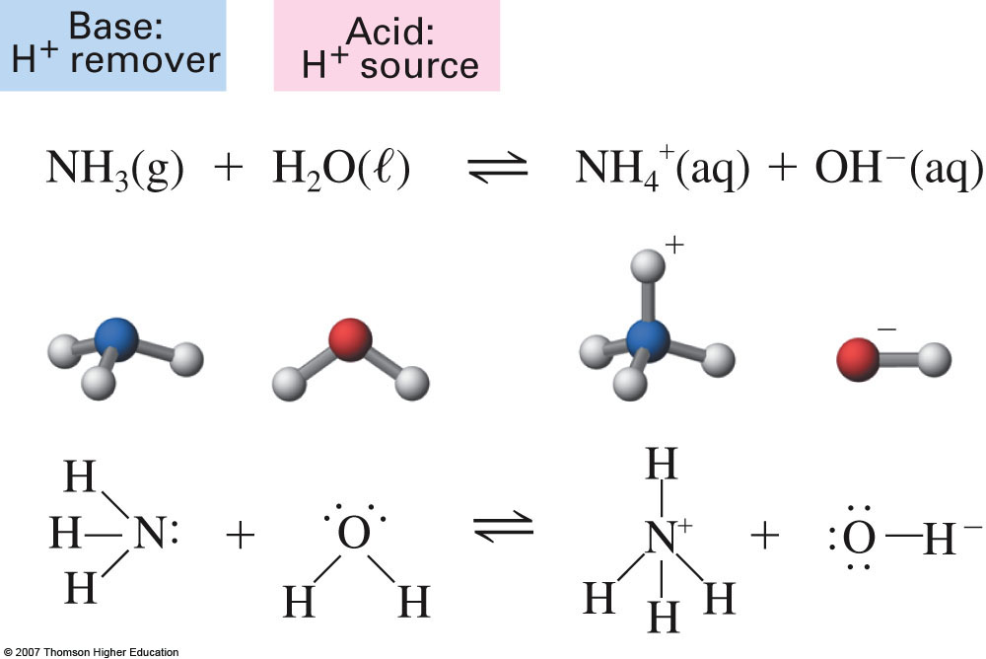
Brønsted-Lowry Theory of Acids & Bases
Reversible reaction

Slide 9
BRONSTED-LOWRY CONCEPT
Definition of acid dissociation constant (K_{a}): K_{a} is the product of equilibrium constant of proton transfer process (K_{eq}) and the concentration of the reference base with respect to which the extent of proton being measured
For strong acids K_{a}$>$ 1 and PK_{a} is negative
For weak acids K_{a}$<$ 1 and PK_{a} is positive

Slide 10
BRONSTED-LOWRY CONCEPT
Relative strength of Acids & Bases: Differentiating and Levelling solvents in the light of Bronsted-Lowry Concept:
To measure the strength of an acid that means the proton donating strength of an acid, the solvent is taken as reference base.
The extent of proton transfer depends on: 1. proton donating power of an acid. 2. Proton accepting power of the reference base participating in proton transfer equilibrium
In aqueous medium
Acid₁ (A₁) + Base₂(H₂O)$⇌$ Base₁ (B₁) + H₃O⁺ (Acid₂)
K_{eq} = $\frac{\left[H_{3}O^{+}\right][B_{1}]}{\left[A_{1}\right][H_{2}O]}$
The extent of proton transfer is measured by the equilibrium constant, K_{eq} (in dilute solution)
The conventional acid dissociation Constant K_{a} is given by:
K_{a} = K_{eq}[H₂O] = $\frac{\left[H_{3}O^{+}\right][B_{1}]}{\left[A_{1}\right]}$
In dil. solution [H₂O] = 55.5 modes per lit, K_{a} = 55.5 x K_{eq}

Slide 11
BRONSTED-LOWRY CONCEPT
Relation between $K_{a}$ and $K_{b}$
The strength of base (B) can also be expressed by considering the following equilibrium to produce a hydroxyl ion in aqueous solution.
base₁ (B₁) + acid₂ (H₂O) $⇌$ acid₁ (BH⁺) + base₂(OH⁻)
K_{eq} = $\frac{[BH^{+}][OH^{−}]}{\left[B\right][H_{2}O]}$, K_{b} = K_{eq}[H₂O] = $\frac{[BH^{+}][OH^{−}]}{\left[B\right]}$,
The base strength of B can also be expressed in terms of K_{a} of its conjugate acid BH⁺.
BH⁺ (A₁) + H₂O (B₂) $⇌$B (B₁) + H₃O⁺ [A₂]
K_{b(B)} = K_{eq}[H₂O] = $\frac{[BH^{+}][OH^{−}]}{\left[B\right]}$; K_{a(BH+)} = $\frac{[B][H^{+}]}{\left[{BH}^{+}\right]}$,
K_{b(B)} x K_{a(BH+)} = [H⁺][OH⁻] = K_{w}
pKa + pKb = pKw = pH + pOH (pKa = -logKa)
For strong acid: $K_{a}$ high
p $K_{a}$ low
${ K}_{b}$ of conjugate base is low
p$K_{b}$ of conjugate base is high

Slide 12
BRONSTED-LOWRY CONCEPT
For conjugate Acid - Base pair → if acid is strong then conjugate base is weak and vice versa.
H₂O + H₂O $⇌$ H₃O⁺ + OH⁻; K_{H2O} = K_{eq}[H₂O] = $\frac{\left[H3O+\right][OH−]}{[H2O]}$ = $\frac{Kw}{[H2O]}$;
K_{w} = K_{H2O}[H₂O] = constant $≈$ 10⁻¹⁴ (at 25⁰C)
If reference base (ie solvent under consideration) is a very good proton acceptor then for different acids, the extent of proton transfer may occur almost 100%. That means all the acids are almost completely dissociated. So all such acids appear to be equally strong. Such solvents (ie reference base) are referred to as levelling solvents with respect to the acids.
Ex. HCl (A₁) + H₂O (B₂) $⇌$ Cl⁻ (B₁) + H₃O⁺ (A₂)

Slide 13
BRONSTED-LOWRY CONCEPT
For Levelling solvent, basicity of solvent$>$ conjugate base of that acid.
NH₃ is levelling solvent for HF, HCl, HBr, CH₃COOH etc. Here proton transfer occurs almost completely. We can not measure the relative acid strength of HF, HCl, HBr, CH₃COOH in NH₃ as solvent (acting as base).
H₂O is differentiating solvent for HF, HCl, HBr, CH₃COOH etc.
H₂O is levelling solvent for much stronger acids- HClO₄, HNO₃, HI, H₂SO₄ etc.
Much weaker base CH₃COOH is differentiating solvent for acids – HClO₄, HNO₃, HI, H₂SO₄ etc.
basicity of NH₃ $>$ H₂O $>$ CH₃COOH
To differentiate the acid strengths of the fairly strong acids, a weak acid (proton acceptor) is to be taken as the reference solvent

Slide 14
BRONSTED-LOWRY CONCEPT
To level the acid strengths, a good proton acceptor is to be taken as a reference solvent. In fact a particular solvent may act as a differentiating solvent for some acids and it may also act as a levelling one for some other acids. Similarly, the acidic solvents (e.g. HF, CH₃COOH) will level off the bases while the basic solvents (e.g. NH₃) will differentiate the bases.
For levelling solvent, basicity of solvent > conjugate base of that acid. For ex. HCl (A₁) + H₂O (B₂) $⇌$ Cl⁻ (B₁) + H₃O⁺ (A₂). Here H₂O is levelling solvent for HCl and basicity of H₂O > basicity of Cl⁻
Now the autoionization of the amphiprotic compounds are as followes
H₂O (A₁) + H₂O (B₂) $⇌$ H₃O⁺ (A₂) + O$H^{−}$ (B₁)
NH₃ (A₁) + NH₃ (B₂) $⇌$ NH₄⁺ (A₂) + N$H_{2}^{−}$ (B₁)
H₂SO₄ (A₁) + H₂SO₄ (B₂) $⇌$ H₃SO₄⁺ (A₂) + HS$O_{4}^{−}$ (B₁)
All the proton transfer process can be regarded as neutralization process.
CH₃CO₂H (A₁) + O$H^{−}$ (B₂) $⇌$ CH₃C$O_{2}^{−}$ (B₁) + H₂O (A₂)

Slide 15
BRONSTED-LOWRY CONCEPT
Strength of Bronsted acids
The acid strength strongly depends on the nature of the solvent which generally acts as the reference base. Thus, the very strong acids (in water) like HCIO₄, CF₃CO₂H, etc. are only slightly acidic in H₂SO₄, H₃PO₄ is a weak acid in water but in H₂SO₄ it acts as a weak base. In general, to describe the relative strength of the acids, we consider water as a solvent, i.e. reference base.

Slide 16
BRONSTED-LOWRY CONCEPT
Ionic Product of Water
The poor electrolyte water dissociates as
H₂O + H₂O $⇌$ $H_{3}O^{+}$ + $OH^{−}$
Applying the law of mass action, the equilibrium constant
K_{eq} = $\frac{a_{H^{+}.}{ a}_{{OH}^{−}}}{a_{H2O}}$;
In the pure state or in dilute solution $a_{H2O}$ is constant and it is taken as unity ($a_{H_{2}O}$ = 1).
Therefore, $a_{H^{+}}×{ a}_{{OH}^{−}}$ = K_{w} = ionic activity product of water
K_{w} = $c_{H^{+} }f_{H^{+}} c_{H^{+} }f_{{OH}^{−}}$ = ($c_{H^{+} }c_{{OH}^{−}}$) $f_{H^{+}}f_{{OH}^{−}}$
K_{w} = K_{w}$ˊ$ $f_{H^{+}}f_{{OH}^{−}}$ [where K_{w}$ˊ$ = $c_{H^{+} }c_{{OH}^{−}}$ = ionic product of water]
In pure water of in dilute solutions the activity coefficients $f_{H^{+} }$and $f_{{OH}^{−}}$ are almost unity, so K_{w} = K_{w}$ˊ$

Slide 17
BRONSTED-LOWRY CONCEPT
In concentrated solutions, K_{w}$ˊ$ varies considerably but K_{w} remains constant at any given temperature. The value of Kw is temperature dependent as it is an equilibrium constant.
$a_{H^{+}}×{ a}_{{OH}^{−}}$ = K_{w} = constant at a particular temperature
K_{w}$ˊ$ = $[H^{+}][ {OH}^{−}]=$(1 $×$ ${10}^{−7}]^{2}$ = ${10}^{−14}$ $M^{2}$
The density of pure water is 1000 g/L and the molar mass of water is 18 g/ mol.
Now [H₂O] = $\frac{1000}{18}$ = 55.55 M
Concentration of water is 55.55 M
Concentration of dissociated water at 25$℃$ is ${10}^{−7}$ M (as H₂O $⇌$ $H^{+}$ + ${OH}^{−}$)
Concentration of undissociated water is (55.55 - ${10}^{−7}$) M $≈$ 55.55 M

Slide 18
BRONSTED-LOWRY CONCEPT
Merits of the Bronsted-Lowry Concept
It defines the acids and bases in terms of the substances themselves not in terms of their ions in aqueous solution or any other solvent.
The acidic and basic nature of substances in the gas phase could be conveniently explained by this theory.
the basic nature of substances that do not contain ${OH}^{−}$ ions could also be explained on the basis of the protonic concept.

Slide 19
BRONSTED-LOWRY CONCEPT
Limitations of the Bronsted-Lowry Concept
The acidic nature of substances that do not contain hydrogen cannot be explained. Eg. CO₂, SO₂ etc.
It defines the acids and bases in terms of the proton transfer process, but there are many reactions in which no proton transfer occurs, e.g.
BF₃+ NH₃ $⇌$ F₃B$←$NH₃
CaO + SiO₂ $⇌$ CaSiO₃
SO₂ + SO₂ $⇌$ ${SO}^{2+}$ + ${SO}_{3}^{2−}$
In order to explain the nature of acids and bases in cases where there is no role for protons, a more advanced theory was proposed that introduced the electronic concept of acids and bases.

Slide 20
LEWIS CONCEPT
It explains acid-base in terms of electron pair acceptance and donation.
Acid: Any species capable of accepting lone electron pair
Base: Any species capable of donating lone electron pair
Neutralisation process: Coordinate bond formation between acid (A) and base (B). Hence for neutralisation adduct AB is formed.
This type of interaction is favoured when the HOMO of base & LUMO of acid are comparable energy. An the adduct (AB) formation the HOMO of base B (bonding MO) and LUMO of acid, A (antibinding MO) participate in the formation of MO in which the e pair resides in bonding MO which is generally richer in character of HOMO of B.

Slide 21
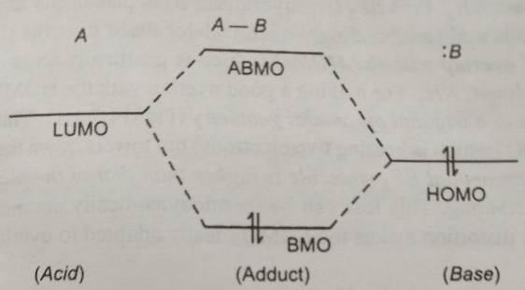
LEWIS CONCEPT
HOMO of base and LUMO of acid interact to form adduct.

Slide 22
Comparison between Bronsted and Lewis acid base concept
1. All Bronsted base are definitely Lewis base, because Bronsted base are capable of accepting protons while Lewis bases are capable of donating lone pair. To bind a proton a lone pair is required (ex. NH₃)
2. But all Lewis base may not be Bronsted base. C₂H₄, C₂H₂, C₆H₆ etc. can act as Lewis base but they can never act as Bronsted base. Example
Cr + 2C₆H₆ $⇌$ Cr(C₆H₆)₂
Cu⁺ + 2C₂H₄ $⇌$ [Cu(C₂H₄)₂]⁺
3. Bronsted acid HA is an adduct of Lewis acid H⁺ and Lewis base A⁻.
HA $→$ Bronsted acid, also adduct according to Lewis concept
A⁻ $→$ Lewis base
H⁺ $→$ Lewis acid

Slide 23
Different Types of Lewis Acids
Based on electronic configuratin
1. H⁺ (The proton): Since charge/redius ratio of H⁺ is very high, it is the most powerful Lewis acid. In polar solvent like H₂O or NH₃ it remains as solvated form.
2. Cations (ie Metal ions, M^{+n}): Central metal ions (specially the transition metal ions) in coordination complex are Lewis acids. They can accept electron pair from ligands which acts as Lewis base
e.g. Cu⁺² in [Cu(NH₃)₄]²⁺, Cu²⁺ + 4NH₃ $⇌$ [Cu(NH₃)₄]²⁺

Slide 24
Different Types of Lewis Acids
Based on electronic configuratin
3. Molecule with central atom having an Incomplete octet:
(a) Halide compounds of Gr-III eg. BX₃, AlX₃ (x = halogen) are e deficient compound. To fulfill octate they form adduct with Lewis base BF₃+ NH₃ $⇌$ F₃B$←$NH₃
In fact in BX₃ internally Lewis acid- base adducts are formed through P_{π}(B) $←$ P_{π}(A) back bonding. AlCl₃ undergo dimerization (forms Al₂Cl₆) through Lewis acid- base interaction to remove electron deficiency.
(b) In some cases, during the Lewis acid-base adduct formation oxidation may take place (oxidative addition). These are
R₃P: + O $⇌$ R₃P:$→$ O
:SO₃⁻² + O $⇌$ O₃S⁻²: $→$ O
:SO₃⁻² + S $⇌$ O₃S⁻²: $→$ S
(c) Hydrides of Gr-III can also act as Lewis acids e.g.
B₂H₆ + 2NR₃ $→$ 2H₃B-NR3 (symmetric cleavage of B₂H₆) (R = CH₃)
B₂H₆ + 2NH₃ $→$ [H₂B(NH₃)₂]BH₄ (unsymmetric cleavage of B₂H₆)

Slide 25
Different Types of Lewis Acids
Based on electronic configuration
4. Molecules with the central Atom having vacant d-orbitals:
The central atoms in the halides such as SiF₄, SiCl₄, GeCl₄, TiCl₄, SnX₄, PX₃, SF₄, etc. have vacant d-orbitals to accommodate the lone pair of the Lewis base
SiF₄ + 2F- $⇌$ SiF₆²⁻
SbF₄ + F- $⇌$ SbF₆⁻
5. Molecules having Multiple bonds" between the atoms of different electronegativity:
In such cases when the Lewis base approaches to the less electronegative centre, the π-electron cloud gets polarized to facilitate the attack by the base at the less electronegative site. Example: CO₂, SO₃

Slide 26
Different Types of Lewis Bases
The species having suitable e clouds for donation are -
1. all anions (X⁻)
2. molecules having unshared electron pair, eg. NH₃
3. Organic comp having π-electron cloud, eg. CH₂=CH₂
Ligands in coordination complex are Lewis base, whether it is only σ donor (e.g. NH₃) or both σ donor and π donor (e.g. OH⁻, H₂O, Halide etc.) or σ donor and π acceptor ligand (e.g. CO, CN⁻, C₂H₄, PR₃ etc). It can act as Lewis base.

Slide 27
Comparison between Lewis acid base reaction with Redox reaction
Both the processes are same in kind but different in degree. In redox reaction. In redox reaction 100% transfer of e occurs, that is, here any number of (1, 2, 3 etc.) e transfer may occurs. But in Lewis acid-base reaction. 100% electron transfer does not occur.

Slide 28
Lewis Acid-Base Property of Xenon Fluorides
Xenon fluorides can act as Lewis bases (i.e. fluoride donors) towards the strong Lewis acids like SbF₅, PtF₅ or AsF₅ which can act as strong fluoride acceptors.
XeF₄ + 2SbF5 → Xe$F_{3}^{+}$ Sb₂$F_{11}^{−}$
XeF₆ + PtF₅ → Xe$F_{5}^{+}$ Pt$F_{6}^{−}$
The xenon fluorides like XeF₄ or XeF₆ can act also as Lewis acids to accept fluorides from alkali metal fluorides.
XeF₄ + MF → M⁺Xe$F_{5}^{−}$
XeF₆ + MF → M⁺Xe$F_{7}^{−}$
XeF₆ + 2MF → M₂[XeF₈]

Slide 29
Merits of Lewis Acid-Base Theory
1. Lewis theory includes both protonic and non-protonic substances as acid.
2. It could provide an explanation for neutralization processes without proton transfer.

Slide 30
Limitations of Lewis Acid-Base Theory
The Lewis theory includes both protonic and nonprotonic substances in this consideration. The inclusion of complex formation definitely broadens the concept over the Bronsted-Lowry concept. But there are some limitations:
(i) It cannot directly explain the acidic property of covalent protonic acids, e.g. HCI, HNO₃, etc. in terms of covalent bond formation by the acids.
(ii) It cannot find out the concept of relative acid-base strength. Thus, Be (II) forms a more stable complex with F than Cu (II), while Cu (II) forms a more stable complex with NH₃ than Be (II), Here, with respect to $F^{−}$, Be (II) is a stronger Lewis acid than Cu (II) but with respect to NH₃, Cu (II) is a stronger Lewis acid than Be (II).
(iii) By definition the acid-base reactions are fast, but many complexation reactions at inert centres like Cr (III), Co (III), Rh(III) etc. are very slow due to kinetic factors.

Slide 31
Reference
Ashim K Das , Fundamental Concept of Inorganic Chemistry, CBC Publishers & Distributors, Volume 3, Second Edition: 2010
R.P. Sarkar, General and Inorganic Chemistry Part-1, NCBA (P) Ltd, 3rd Edition 2011
R.L. Dutta, G.S. De, Inorganic Chemistry, Part I, The new Book Stall, 6th Edition2009, 7th Edition 2013
Wahid U. Malik, G. D. Tuli & R. D. Madan, Selected topics in inorganic chemistry, S. Chand & Company Ltd, first edition 1976
J.E. Huheey, E.A. Keiter, R.L. Keiter, Inorganic Chemistry Principles of Structure and Reactivity, Pearson Education Asia, fourth Edition, 2000

Slide 32
Thank you

